Slide 1


Investigation of Vulnerabilities in Open RAN Implementations
Research Project – WS 22/23
Arnova Abdullah
Weekly meeting-03 (02.11.2022)

Slide 2
Previous Weeks Meeting Details
Week 1 Meeting (19.10.2022)
Basics about Radio Access Network (History, parts of RAN for 1G, 2G, 3G, 4G)
Basics about Open RAN (Distribution unit, central unit, user plane, control plane, interfaces, front haul, mid haul, backhaul)
Open RAN risk analysis (Stakeholders of attackers-User, external attacker, cloud operator**, RAN operator**)
Week 2 Meeting (26.10.2022)
Installation of Kali Linux and Metasploitable
Atomic Red Team GitHub repository download
Research other open-source attack tools

Slide 3
Week 3 Meeting (02.11.2022)
Penetration testing using Kali Linux
Try Atomic tests by invoke-atomic
Get used to commands used for running a test
Research details about one of the attack tools - Infection Monkey
Read research papers on the risk of 5G open RAN

Slide 4
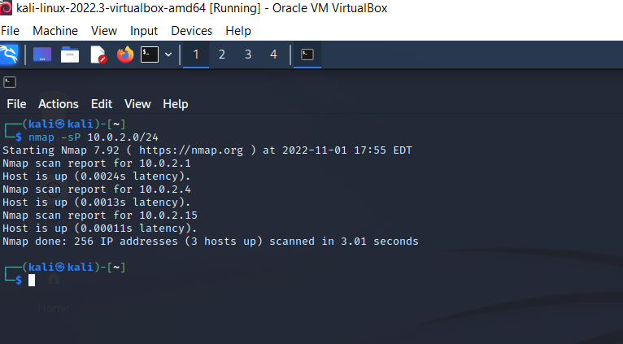
Penetration Testing using Kali Linux
Host Discovery in the same network: nmap –sP 10.0.2.0/24
Metasploitable VM is running and IP address is 10.0.2.4
IP address of the attack machine (kali linux)

Slide 5
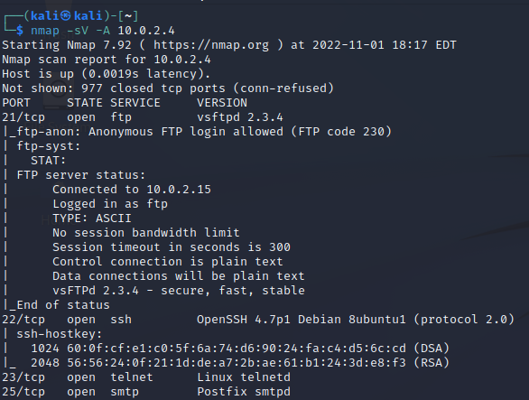
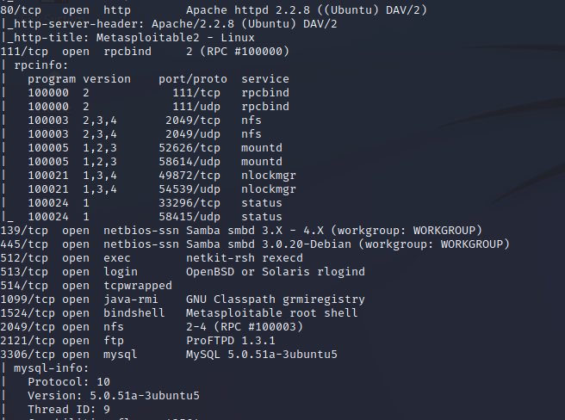
Penetration Testing using Kali Linux
There are many services with open ports in the Metasploitable.
One can gain unauthorized access with open ports using malware or social engineering attacks.
So Metasploitable is a vulnerable system with many open ports services.
Command: nmap –sV –A target_ip
Scanning which network services are available with the target IP address (Metasploitable)

Slide 6
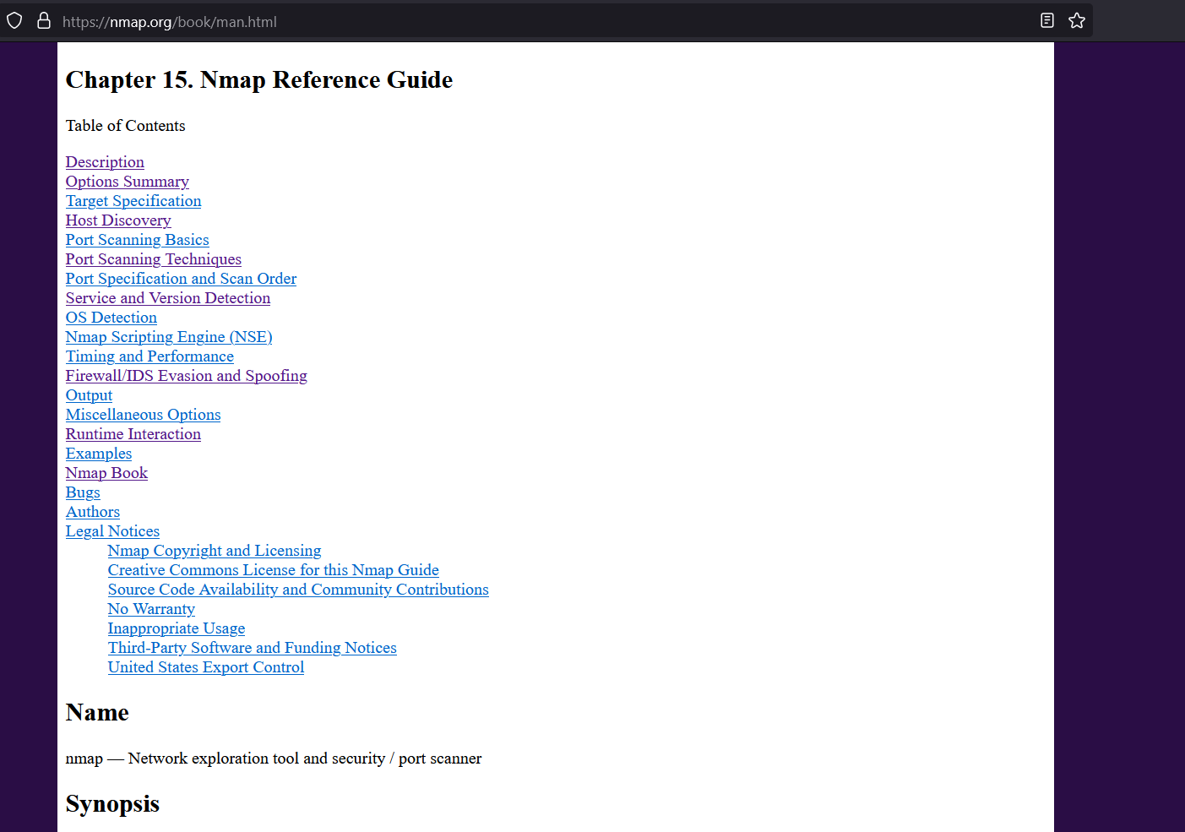
Penetration Testing using Kali Linux
There are other scanning options available for Nmap.
https://nmap.org/book/man.html

Slide 7
Penetration Testing using Kali Linux
2. DOS attack using hping3: https://www.youtube.com/watch?v=KytAmziXs4k
Command: hping3 –S 10.0.2.4 –a 10.0.2.16 –p 80 –flood
Here 10.0.2.4 is the target IP address and 10.0.2.16 is a spoofed address.
This command was run in the terminal of a Linux VM with root access.
Before running this command, the browser was working fine. Wireshark packet capture was also opened.
After this command, there was huge traffic (SYN packet from the spoofed address 10.0.2.16 to the local VM) seen in Wireshark. Also, no website was loading in the browser. I stopped running it as it was using 50% of the RAM.

Slide 8
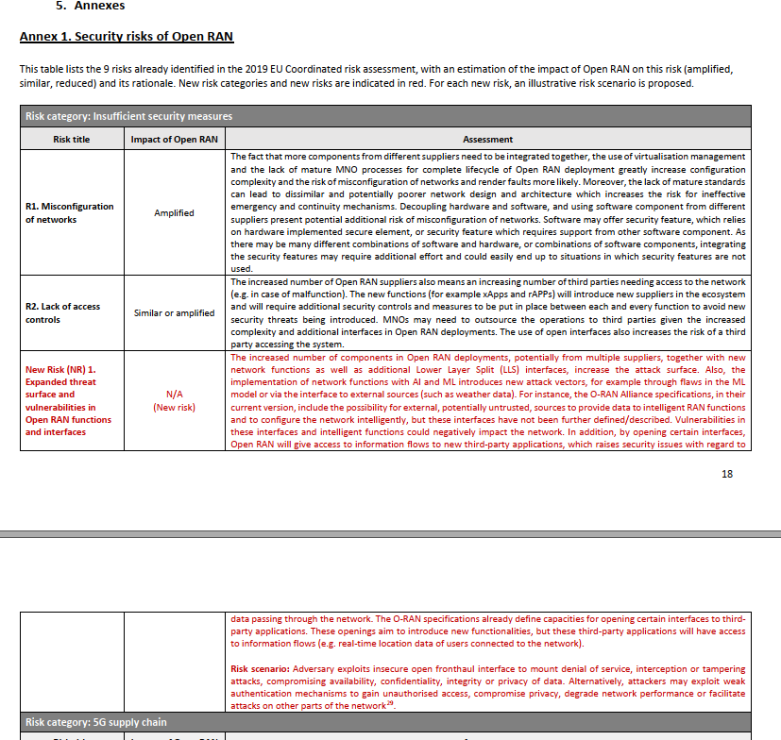
Penetration Testing using Kali Linux
I read some security risks in a report “Report on the cybersecurity of Open RAN – NIS Corporation group” on page 18.
Here, a new risk is defined for the open front haul interfaces. A risk scenario can be mounting a DOS attack to evaluate vulnerabilities.
That’s why I tried to test a DOS attack described on the previous page.

Slide 9
Atomic Test by Atomic Red Team
I followed the installation and test instructions on the git hub page.
https://github.com/redcanaryco/invoke-atomicredteam/wiki/Installing-Invoke-AtomicRedTeam
Invoke-AtomicRedTeam is an execution framework for the tests.
It is run in the PowerShell Core.
PowerShell Core is installed in a Linux VM using the command: sudo apt-get install -y powershell classic
For PowerShell version: pwsh –version
After importing the invoke-atomic module as per instruction from the GitHub page, I tried the command to list all the attacks with ID and name:
Command: Invoke-AtomicTest All -ShowDetailsBrief

Slide 10
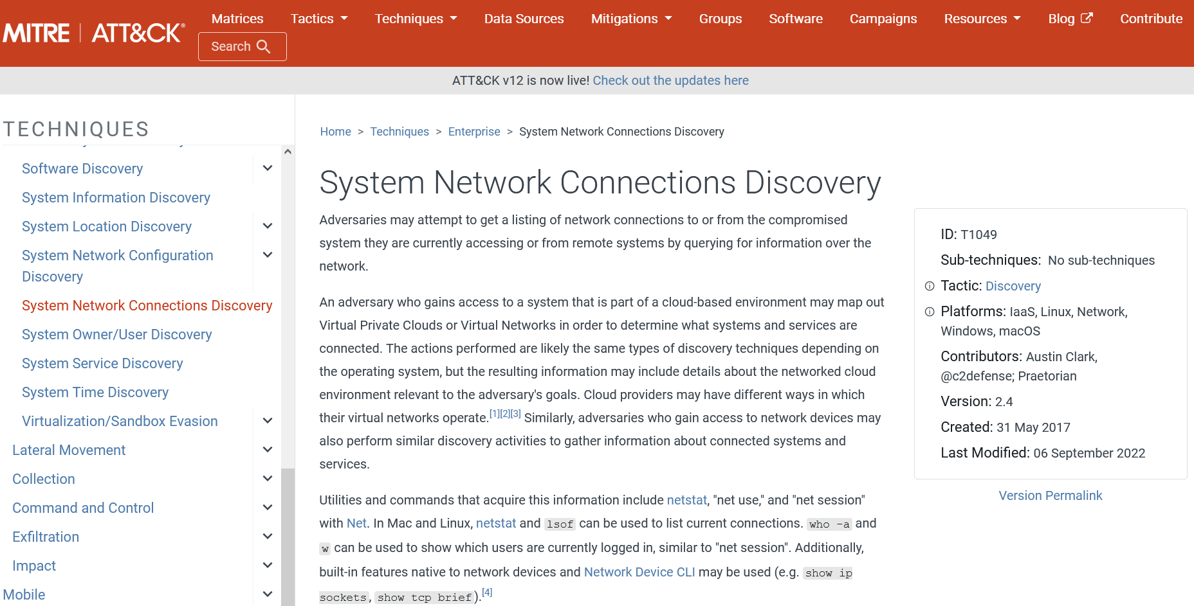
Atomic Test by Atomic Red Team
Tried this attack with ID T1049 for system network discovery: Invoke-AtomicTest T1049

Slide 11
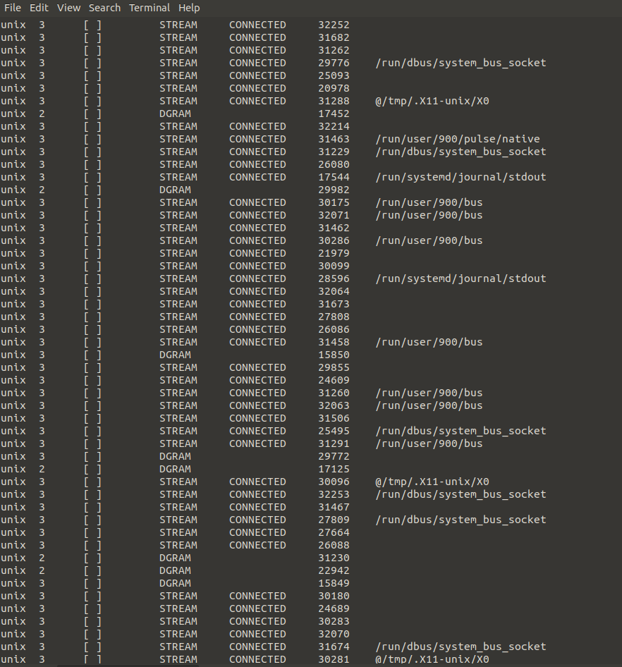
Atomic Test by Atomic Red Team
This attack ID was chosen randomly from the list.
This is the output of the atomic test with the attack id T1049.
There are different attacks for enterprise, mobile and ICS in the Mitre ATT&CK.
Now one of the challenges would be to find the most relatable attack for open RAN in the attack list (https://attack.mitre.org/techniques/)

Slide 12
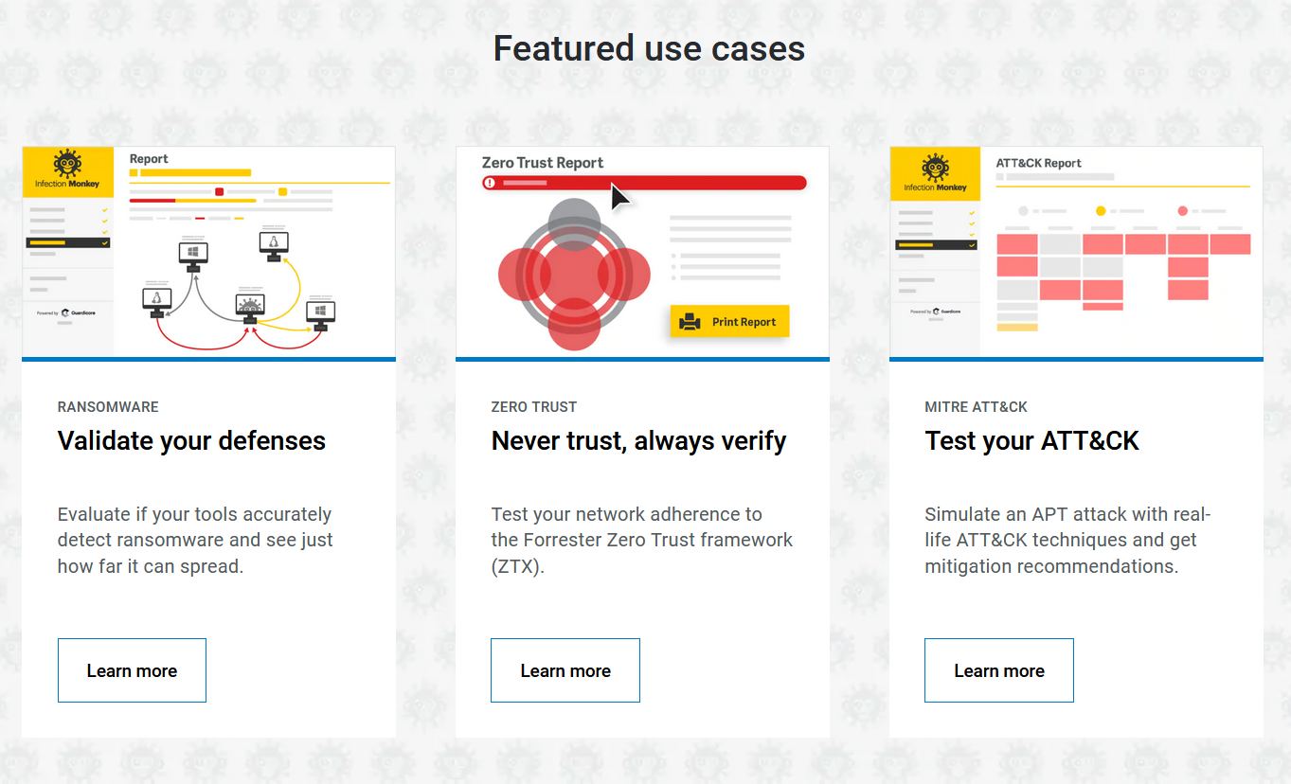
Infection Monkey
There are some interesting use cases besides the Mitre attack list in the infection monkey. And Docker is a supported platform for these use cases.

Slide 13
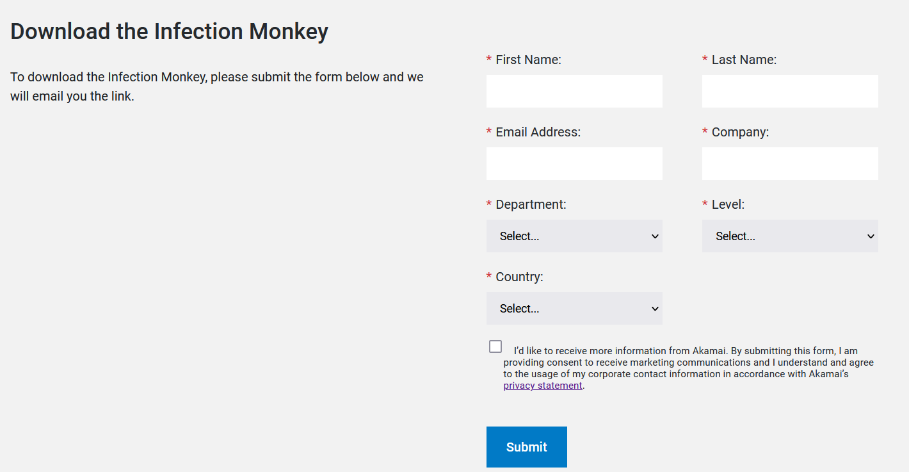
Infection Monkey
I couldn’t research much about Infection Monkey. It seems like it is similar to the atomic red team. It requires the company name and department name for download. Professor, should I proceed with the company name as “TH Köln”?

Slide 14
Read research papers on the risk of 5G open RAN
I have been reading some parts of some research papers while working with these attack tools.

Slide 15
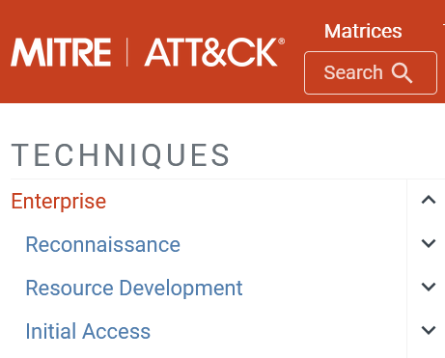
Next Steps (Until 09.11.2022)
Finding the most relatable attacks from the MITRE ATTACK list
Reading literature about the interfaces of Open RAN in 5G
What could be the possible attacks on the interfaces?
Analyzing the enterprise attack techniques --------------------→
Learning how to install kali Linux and other tools in the Docker container.
If Infection Monkey is downloaded, then get used to this tool.
If Infection Monkey is not downloaded then investigate Caldera.
Professor Knospe has offered a Netacad e-learning course CyberOps in the IT security course. It seems really helpful and relatable for evaluating more about attack scenarios and attack tools. I will be continuing to do this course besides other plans.

